Slide 1
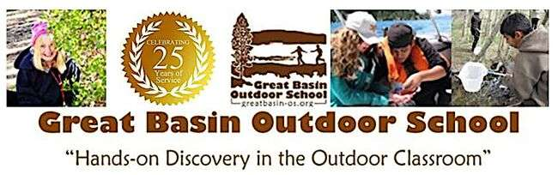
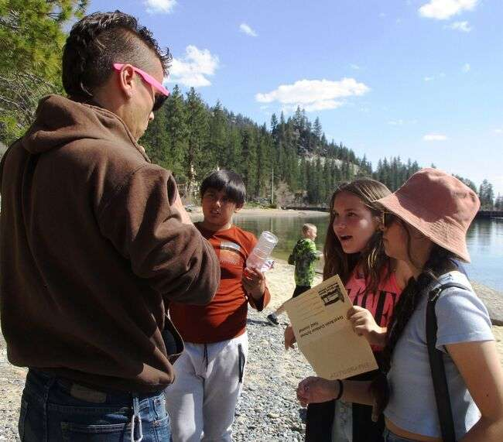
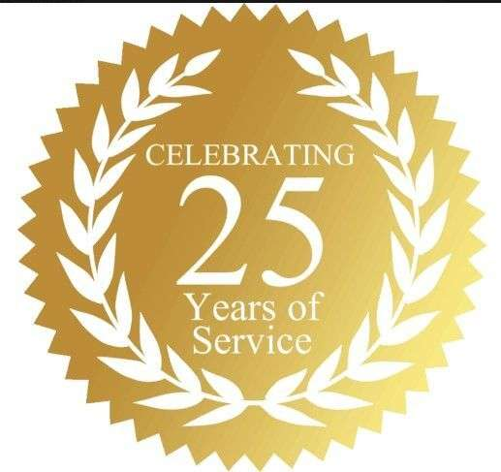

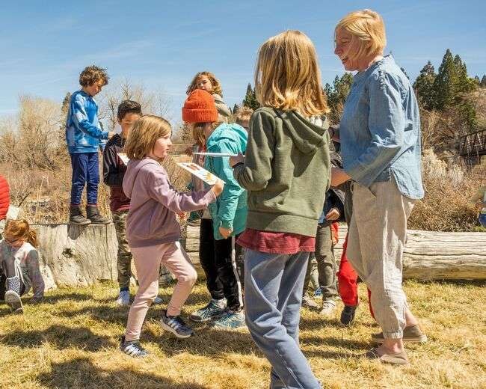
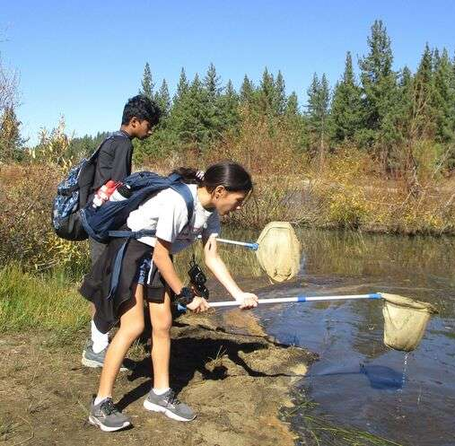
Great Basin Outdoor School
2023 Annual Report
Great Basin Outdoor School is proud to celebrate 25 years as a nonprofit connecting local children with nature and standards-based STEM education on the shore of Lake Tahoe and other northern Nevada sites. Our 25th birthday party was an old fashioned family picnic at Galena Creek where we have shared day field studies with school groups for many years.
Highlights of this special year also include receiving GREENevada’s “Golden Pinecone” award as an exemplary education program and being recognized by OSIT, the governor’s Office of Science, Innovation, and Technology, as a model STEM education provider.

Slide 2
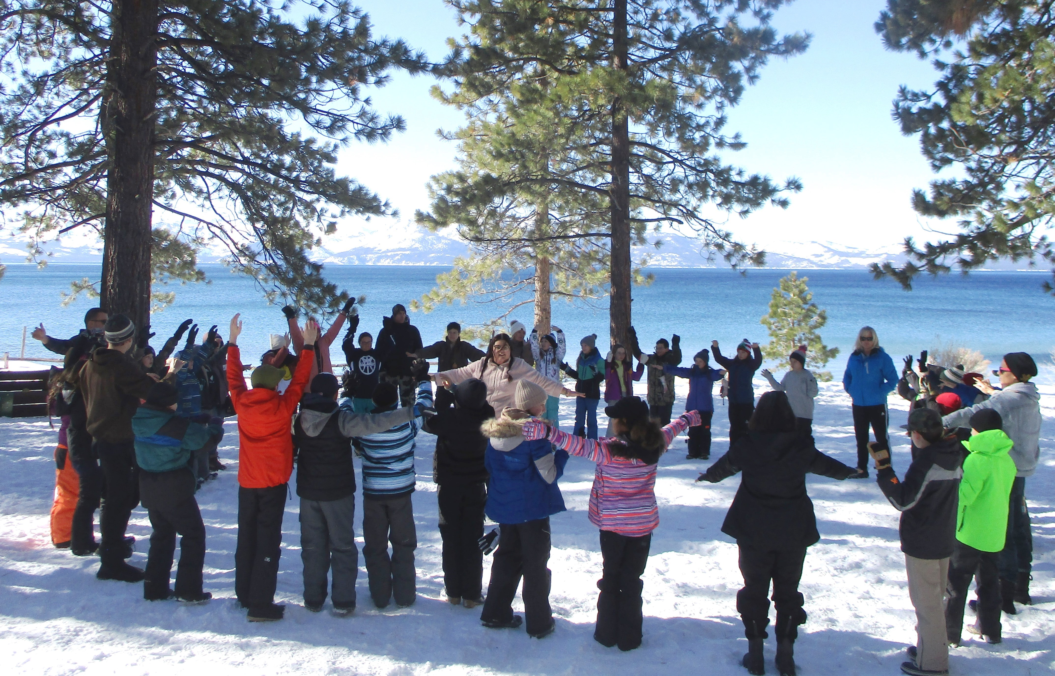
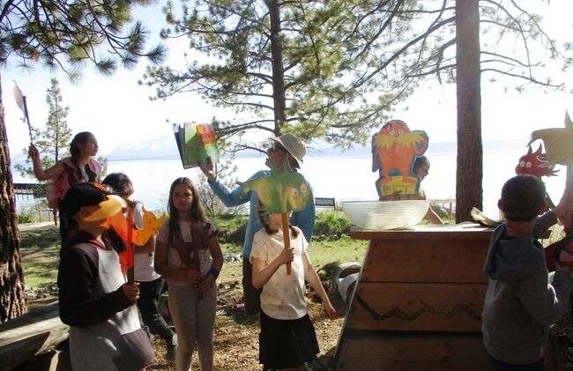
Camp Galilee on Nevada’s Tahoe shore is home base for 2, 3, and 4-day overnight science camps for school classes ably led by Executive Director Emily Baldwin.
Our naturalist educators teach students in small trail groups here in spring, fall, and winter.
Many students had never been to Lake Tahoe, and most had never stayed in a cabin, hiked in the forest, or helped with an environmental stewardship project before.
Thanks to community support, we are able to share many “firsts” with traditionally under-served children.

Slide 3
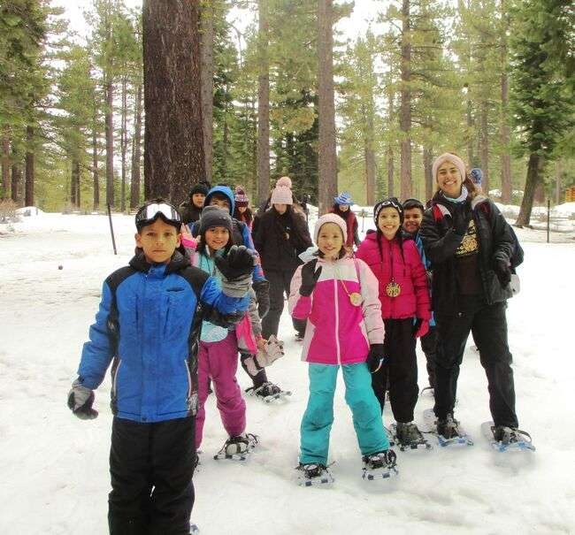
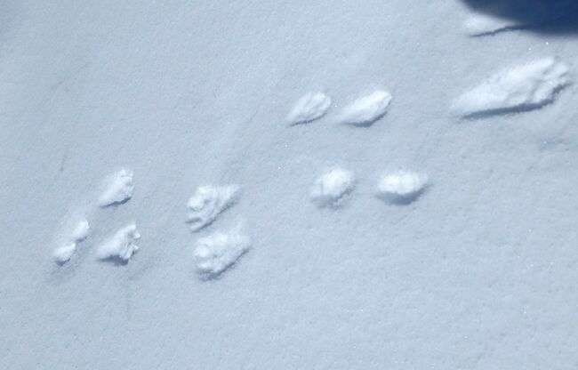
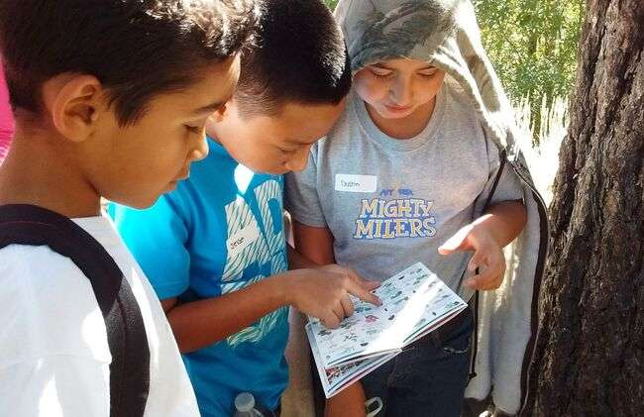
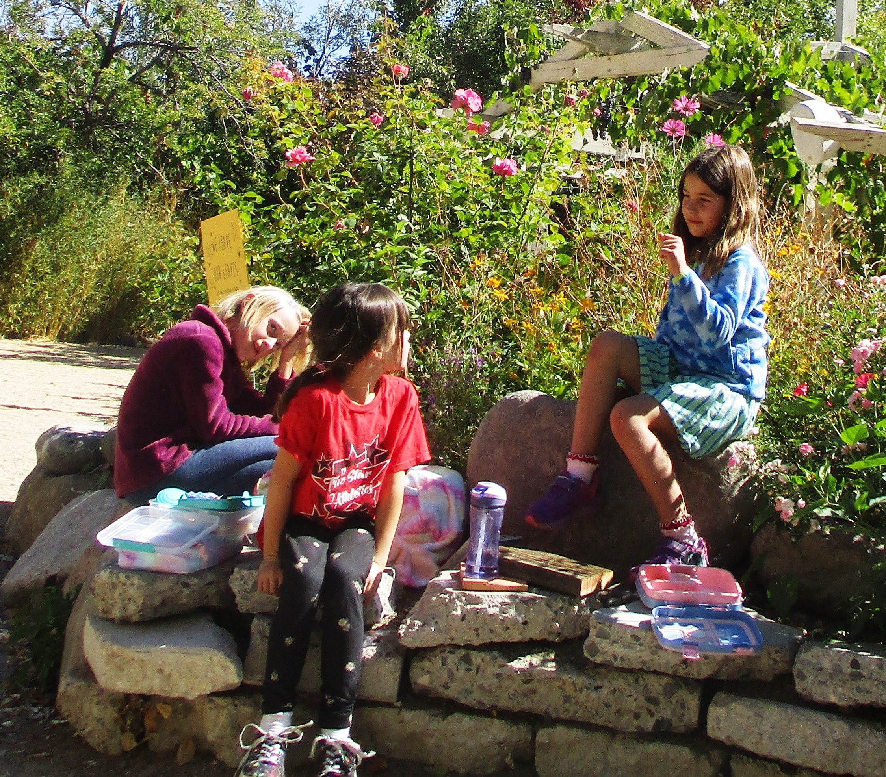
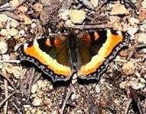
25 years ago we were founded to provide these multi-day overnight science camps in the spring and fall with no idea we’d soon add winter ecology and snowshoeing thanks to Jeni and Brian Root’s donation of snowshoes and snow gear from another program and inspiration from Snowlands and the Winter Wildlands Alliance SnowSchool.
Nor did we foresee offering day field trips for schools, school break day camps, or family hikes, all now key program components.
Our community outreach now also includes annual professional development workshops for teachers, a leadership role in Snapshot Day’s annual citizen science monitoring of the Truckee River, and participation in events such as Earth Day and Back-to-School Night.
One thing that has not changed is our commitment to keeping school programs well below actual cost to include children otherwise missing the life-changing impact of hands-on discovery in the outdoor classroom.

Slide 4

Thanks to community support, we reach 1,200 students annually in a combination of single-day and multi-day programs totaling about 3000 student program days.
Scholarships and fee reductions help include children with the least access to enriching outdoor activities, 62% of our public school students in 2023.
Our multi-day programs ranging from two-to four-day science camps on the shore of Lake Tahoe and five-day school break day camps at the River School Farm in Reno understandably have the most lasting impact on the children, and our day school field trips, usually at Galena Creek or Spooner Lake, provide a welcoming invitation and introduction to outdoor learning adventures.
We schedule 14 weeks of day and overnight science camps for school classes, 10 weeks of school break day camps, seasonal professional development sessions to best prepare our educational staff, 10 monthly family hikes, annual Truckee River Snapshot Day, and an annual Project WET professional development teacher workshop.

Slide 5
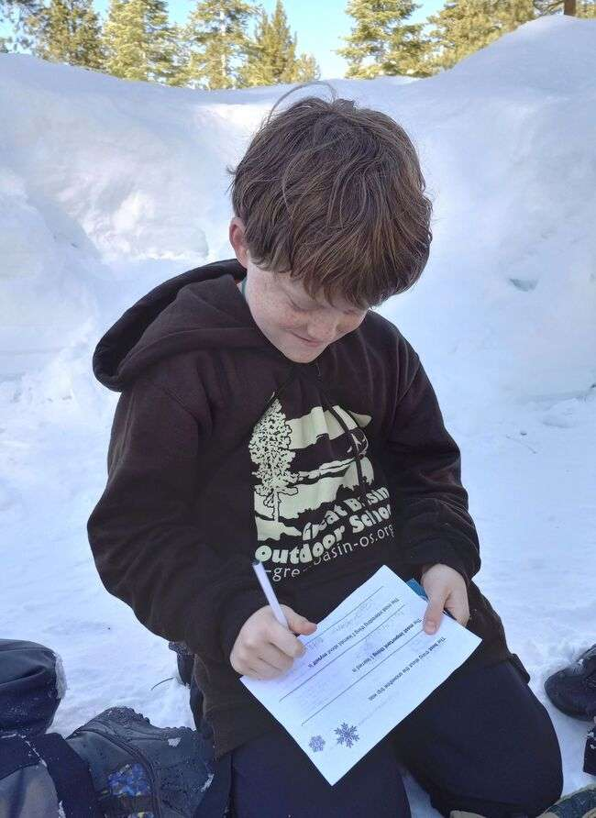
Pre-Assessment and Post-Assessment Results
Students completed pre-and post-assessments to measure knowledge gain and attitude and collect quotes on students’ impressions of their experience.
July day camp assessments documented knowledge gain for 86% of campers. 93% could identify their watershed, 88% identified three phases of the water cycle, 98% identified Leave No Trace principles, and 83% suggested ways to protect environment.
82% of students in our 3-day overnight Tahoe science camp in September said they believed what they do is important and makes a difference after engaging in an environmental service project helping clear a drainage area to reduce sediment draining directly from Highway 50 into Lake Tahoe.
That was a first environmental service project for 57% of them, and 77% then committed to ways they can help protect their watershed. 80% showed an understanding of nonpoint source pollution.
67% said they made new friends, 65% gained self-esteem, 57% increased their interest in science, and 69% said they increased their leadership skills.

Slide 6
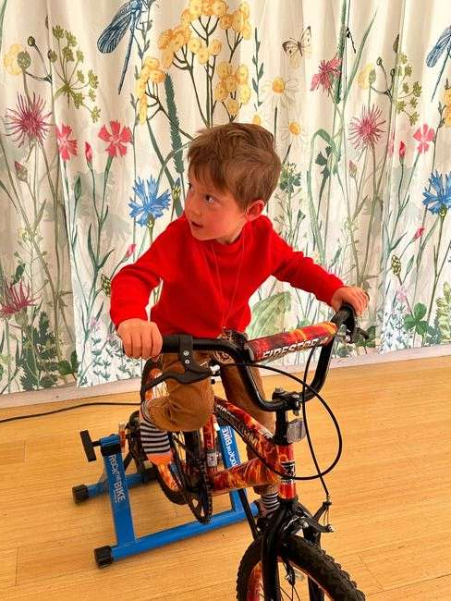
2023 Impacts
1189 students served
108 days of programs
2908 student contact days
1328 total served during all programs
560 students served during single-day programs
629 students served during multi-day programs

Slide 7
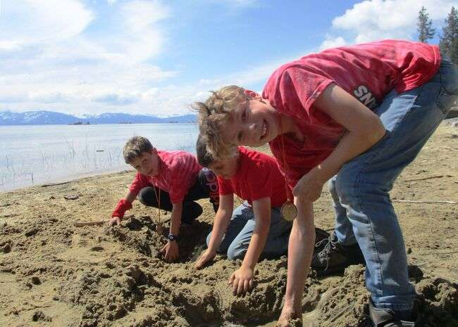
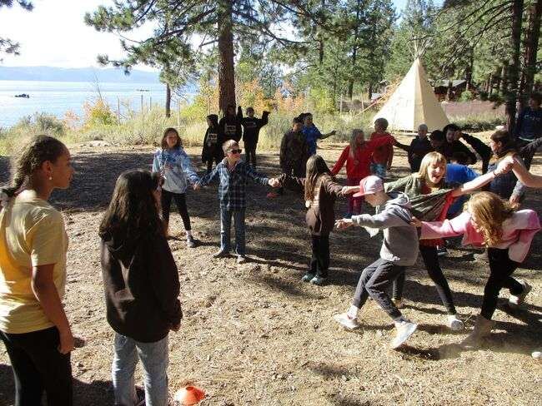
Student Quotes
The BEST thing about Great Basin Outdoor School is:
hanging out with friends and exploring
learning about Lake Tahoe
learning about the environment and learning about stars
hiking and studying new things in the wild
The MOST IMPORTANT new thing I learned is:
to care for the environment
to help protect the earth
to save water and not litter
The MOST INTERESTING thing I learned about myself is:
that I need to care for the environment
that even I can make a difference
I can help the environment
GREAT BASIN OUTDOOR SCHOOL is:
fun, awesome, interesting, cool, unique, exciting, surprising, joyful, encouraging, amazing, educational, caring, beautiful, adventurous, unbelievable, wonderful, one of those things you don’t ever want to leave, best experience, happy.

Slide 8
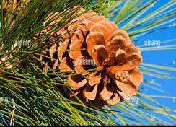
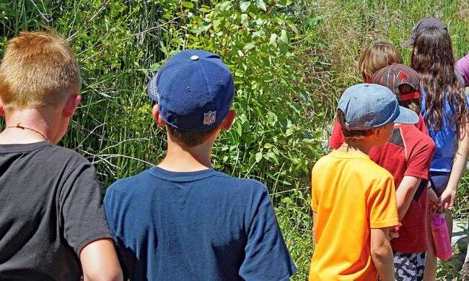
From a Teacher:
“This program encourages them to be more aware of their environmental responsibility to our Earth and the decisions we make.
“Your naturalists were wonderful and well trained. The students enjoyed their activities, songs, and especially the hands-on and physical movement games!”
From a Supporter:
“We visited at Galena Creek and at Lake Tahoe. The kids had a lot of focus and enthusiasm on these field trips, even the day it was raining!
“I‘m a strong advocate for outdoor education, partly based on my own experience teaching at the college level. Concrete, hands-on experience is the key to developing critical thinking about life that will stick with an individual for many years. This not only produces greater understanding of the natural world, but also greater appreciation of nature, which is really the key foundation for conservation and preservation of biodiversity.”
From Summer Day Camp Parents:
"My kids came home with lots of fun facts about animals and plants in our area.“
"Fantastic experience - only disappointment was I didn’t sign them up for more weeks this summer!"
Describe what YOU liked most about Day Camp: "The learning experience my child continues to receive by attending."

Slide 9
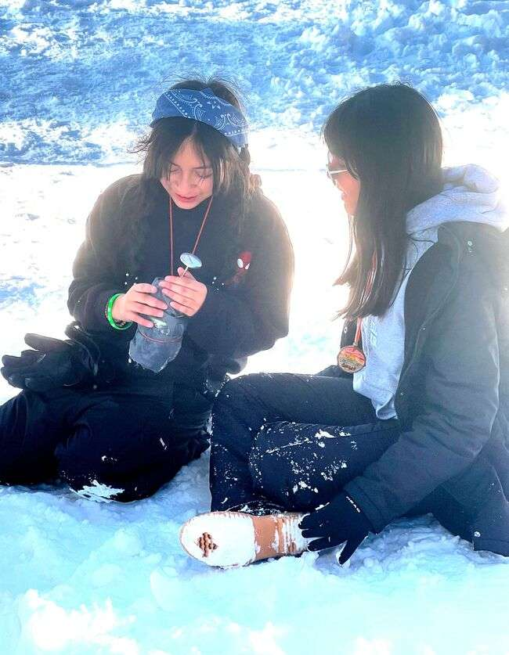
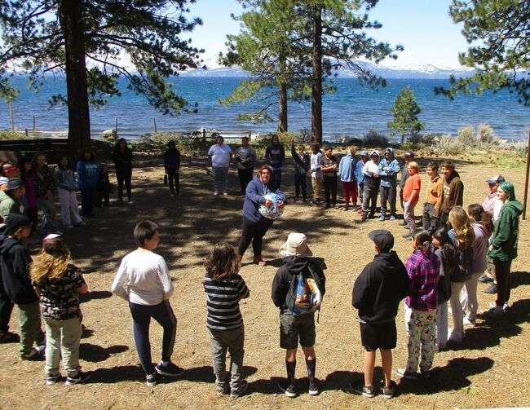
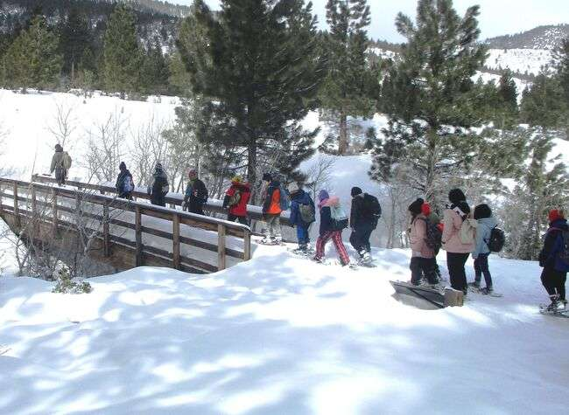
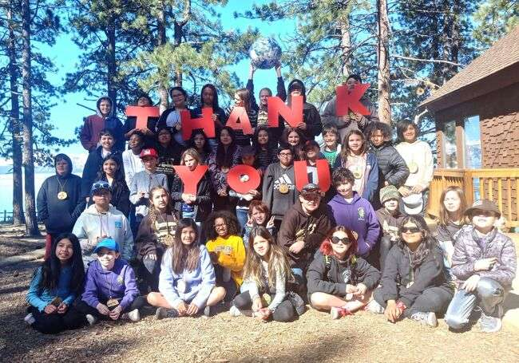
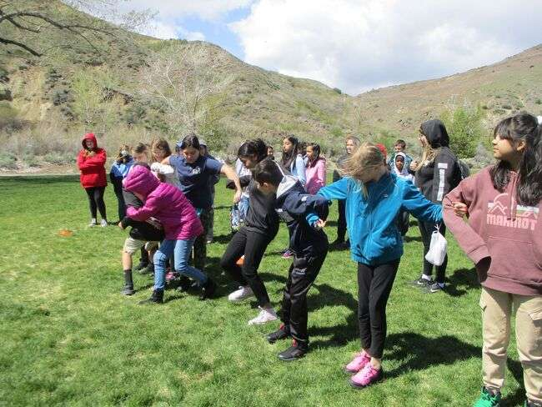
Scholarships
Thanks to our generous support from donors and community members, we were able to award scholarships to 6 schools. 3 of the schools attended our multi-day overnight camp on the shore of Lake Tahoe. The other 3 were attended our day field studies at Galena Creek and Mayberry Park.

Slide 10
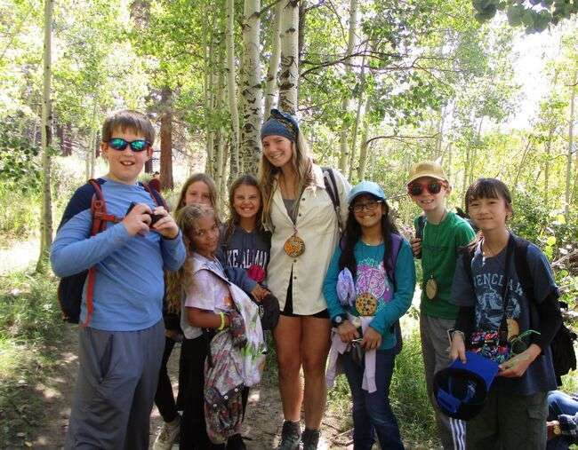
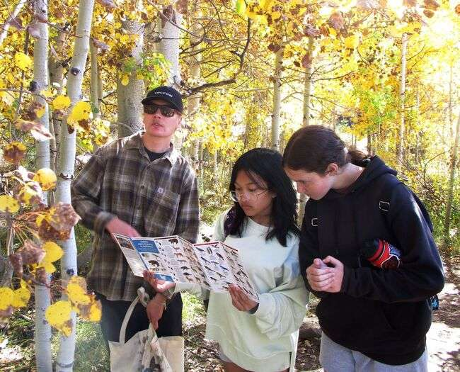
University of Nevada
Volunteers and Interns
These young adults are great role models and share their time, enthusiasm, and science background.

Slide 11
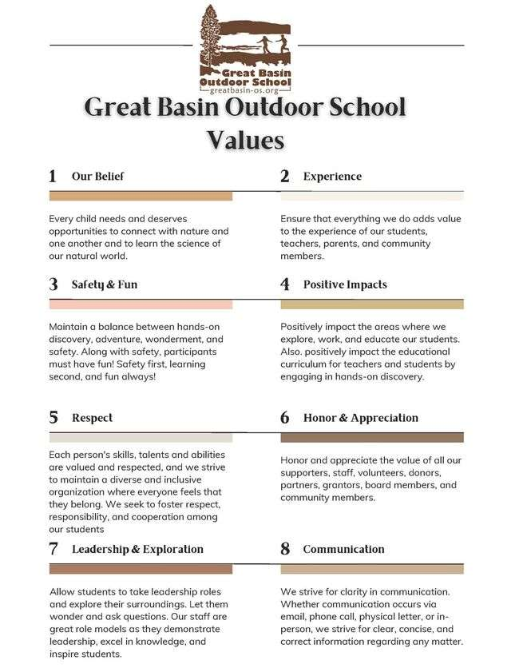
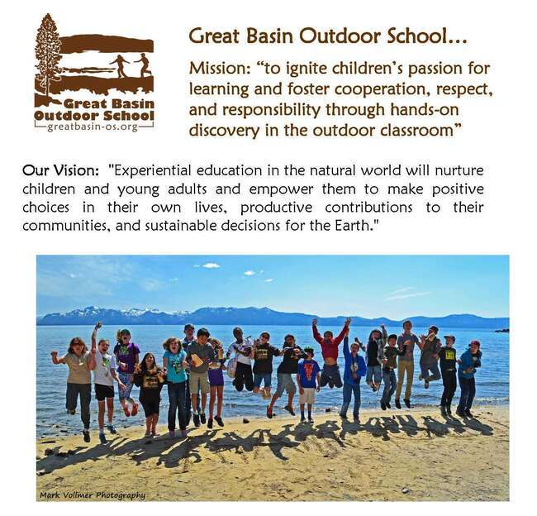
Our mission and vision have remained constant and relevant for decades, and we have recently adopted values.

Slide 12
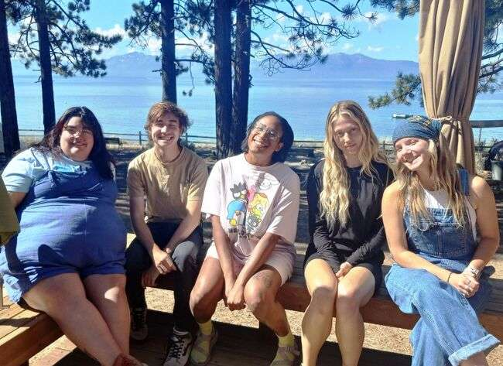
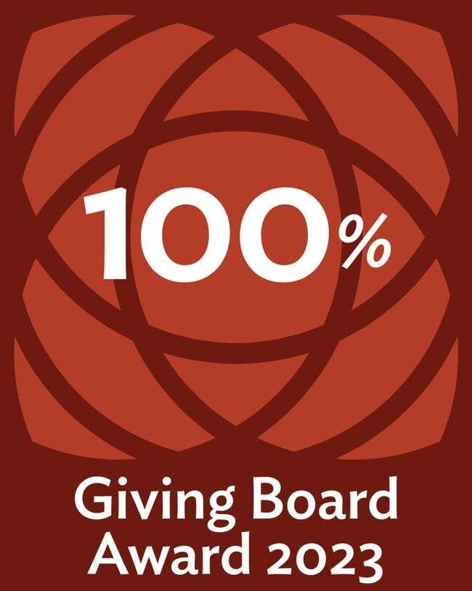
Thanks to Our Board
Each shares valuable skills and each makes
significant financial contributions each year
earning Community Foundation recognition
as a 100% Giving Board.
SUE JACOX, President, Washoe County School District Educator, retired
CALEB S. JENSEN, CPA, Treasurer, Certified Public Accountant
PATTY MOEN, Secretary, Environmental Scientist
LEILANI KONYSHEV, Washoe County School District Educator
DR. RICHARD VINEYARD, Science Education Consultant (through Nov.)
A message from our founding director, Sue Jacox:
"I want children to have what I have and cherish myself. Every day I want them to look at the mountains and the sky and feel inspired and excited. I want them to love Nevada and the earth and to feel a part of their community. I want them to have the skills and the will to make positive choices and to recognize that every choice and every action can make a difference. And finally, I want them to be stimulated by lifelong learning and nurtured by a sense of connection to the natural world."
We love our staff and mentor them in their multiple roles from teaching to administrative duties. They're a small but mighty team giving 110% all the time.
Executive Director Emily Baldwin and Development Coordinator Derik Knak are at the helm supported by seasonal naturalist educators and university interns and volunteers.

Slide 14

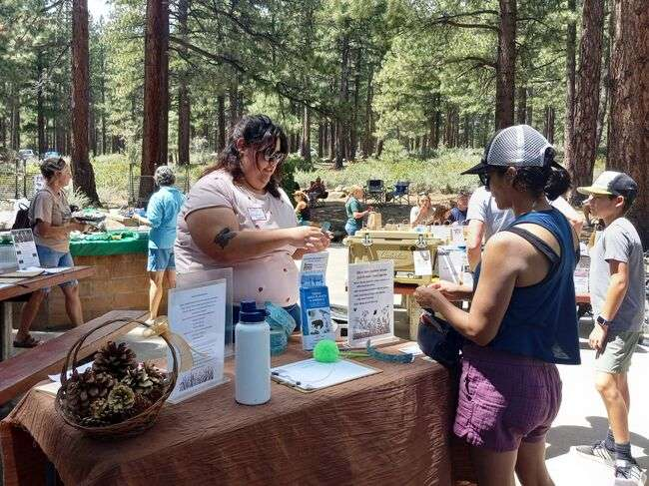

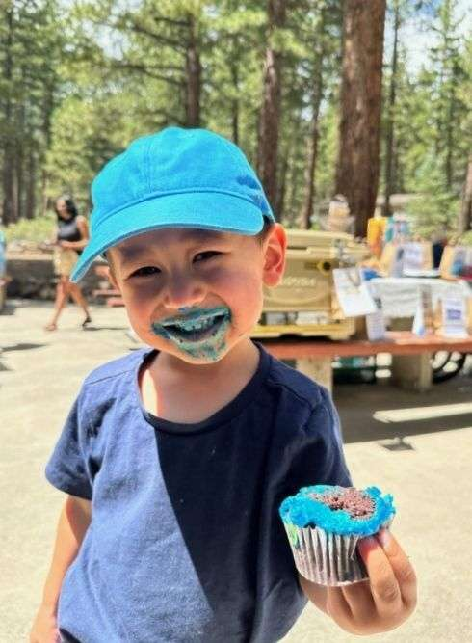
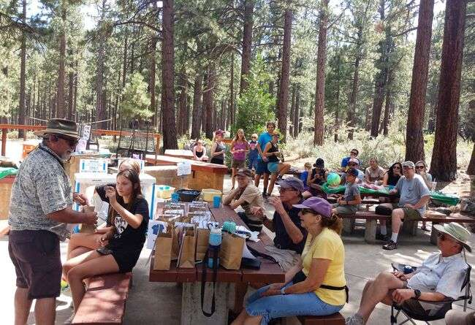
Thanks to the businesses & friends who supported our 25th birthday celebration!

Slide 15
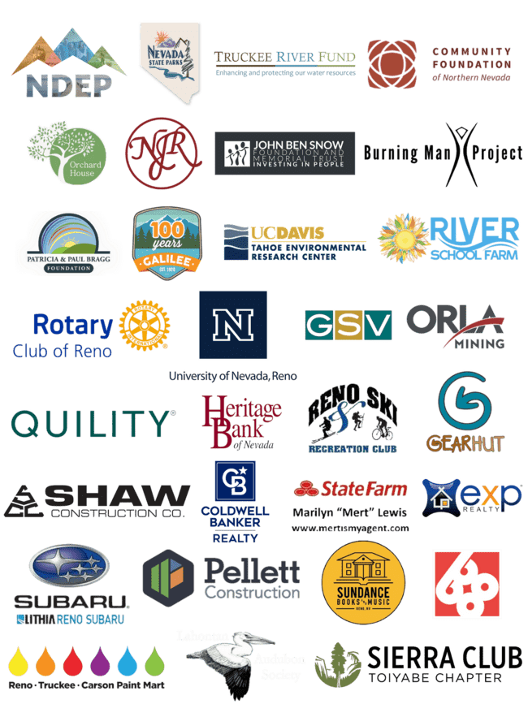

“It takes a village . . .” and we are forever grateful to all our community partners who help us make life-changing experiences possible for hundreds of students each year.
All the friends, agencies, organizations, and businesses who have become our “Great Basin Buddies” keep school program fees well below actual cost to be affordable for classes and allow us to include underserved children with little access to the joys of connecting with nature and learning the science of our natural world. Here are logos of some of our supporters.
Thank you!

Slide 16

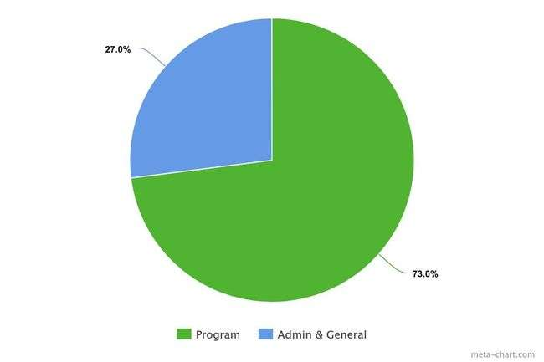

Financials
100% of board members contributed support, and our fundraising and grants always subsidize over 50% of expenses for children in our school programs. Increasing need among local families led us to offer more fee reductions to children and left us with a budget deficit and a determination to seek more community support in 2024. Our IRS Forms 990 are available upon request and on GuideStar’s website at http://guidestar.org/.
Program Fees Grants Donations & Fundraising Total Income | $133,656 $ 69, 487 $ 77,618 $280,761
Program Admin. & General Total Expenses | $220,217 $ 82,363 $302,580

Slide 17
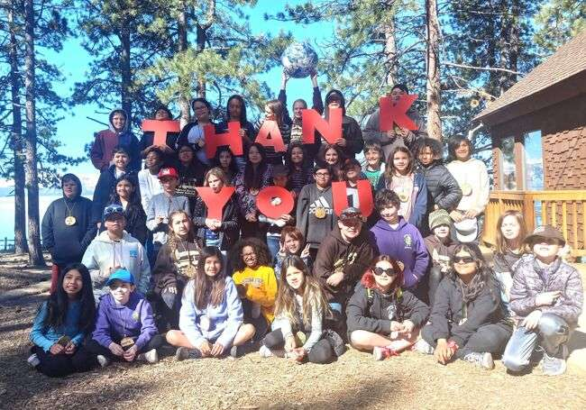
THANK YOU
We wouldn’t be able to do it without your community support!

